Slide 1

Privacy preserving distributed data mining based on secure multi-party computation

Slide 2
Table of Contents
Objectives
Introduction
Problem definition
Task 1
Task 2
Methodology
Algorithms
Solutions
Results
Conclusions

Slide 3
Objectives
To introduce what data mining is
To define two problems to be solved
Explain each task in detail
Provide algorithms 1,2,3 as solutions

Slide 4
Introduction
In recent years, we have witnessed an unprecedented big data explosion than ever before, especially for private data in business environments.
For most companies and organizations that own private big data, such as electronic commerce, online-banking and cross-field research data, the data infrastructure is built on a nationwide or worldwide distributed system.

Slide 5
Problem definition
In this section, we will first introduce two real-world tasks of privacy preserving distributed mining.
Then, we will illustrate the traditional way to solve these tasks by secret sharing, and point out its potential risk of privacy leakage. Finally, we will describe our solutions for these two tasks.
Two problems Task 1: Calculating Statistics of Different Types of Data Task 2: Studying the Relationship between Variables by Linear Regression

Slide 6
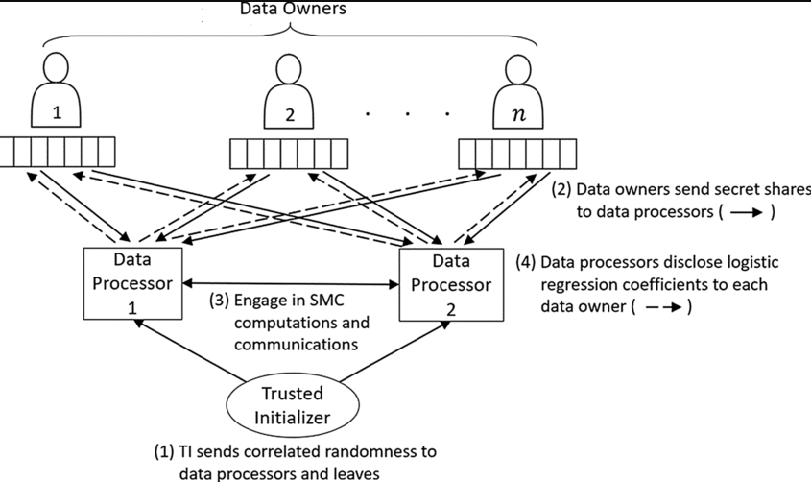
Task 1
Data encryption chart
Here, we first define the problem of calculating statistics of different types of data under privacy preserving distributed data mining condition as:
Given data in the form of 〈type, value〉 tuples, the problem is to calculate the statistical indicators of given data, without privacy leak risk for both type and value in original data.

Slide 7
Task 2
In general, we can use the linear regression to reveal the relationship between variables.
The same concern of business privacy leakage exists if these companies are asked to disclose their trading records to perform linear regression analysis.
Hence, we define the problem of performing linear regression under privacy preserving distributed data mining condition.
Suppose we have a set of tuples formed as <dep_var, indep_var_1,…, indep_var_n> in which <dep_var> and <indep_var> refer to dependent variable and independent variable, respectively. All independent variables in a row compose a matrix A.

Slide 8
Methodology
MPC - multi-party computation
LU - lower–upper (LU) decomposition or factorization factors a matrix as the product of a lower triangular matrix and an upper triangular matrix (see matrix decomposition).
QR - a decomposition of a matrix A into a product A = QR of an orthonormal matrix Q and an upper triangular matrix R.
Data mining - process of extracting and discovering patterns in large data sets involving methods at the intersection of machine learning, statistics, and database systems.

Slide 9
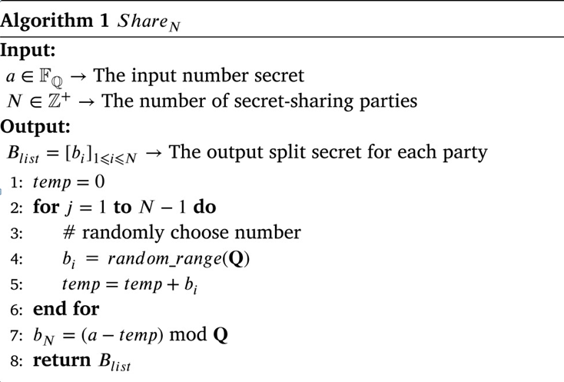
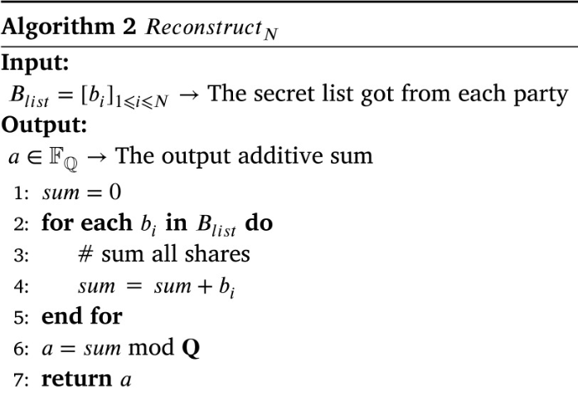
Algorithm 1,2

Slide 10
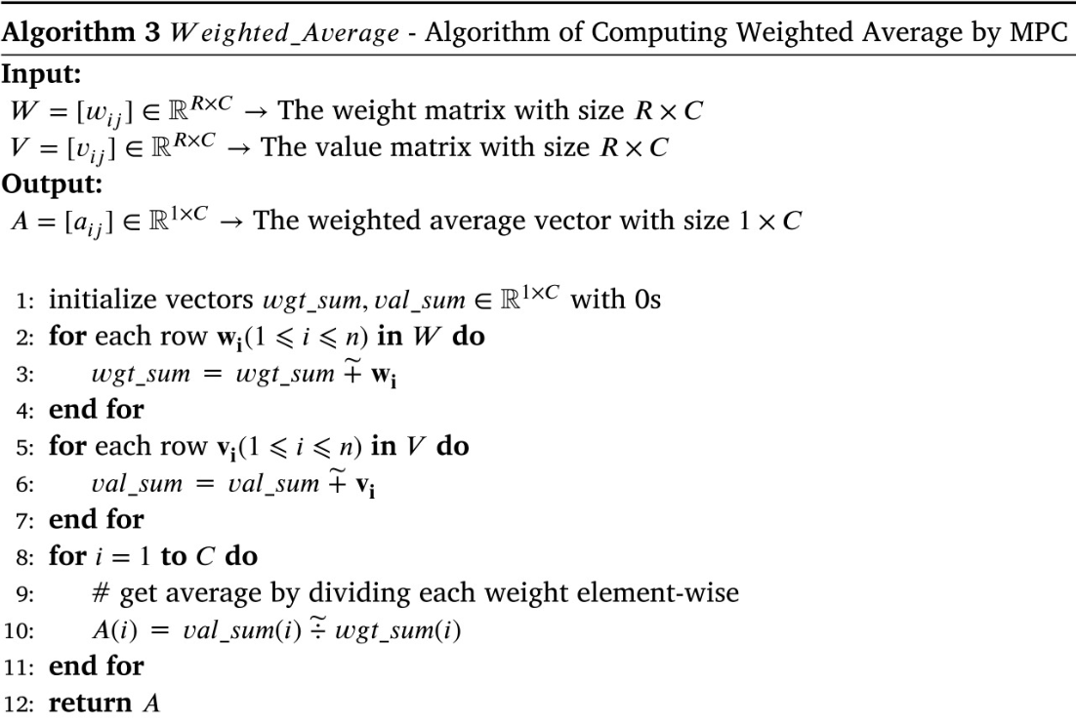
Algorithm 3

Slide 11
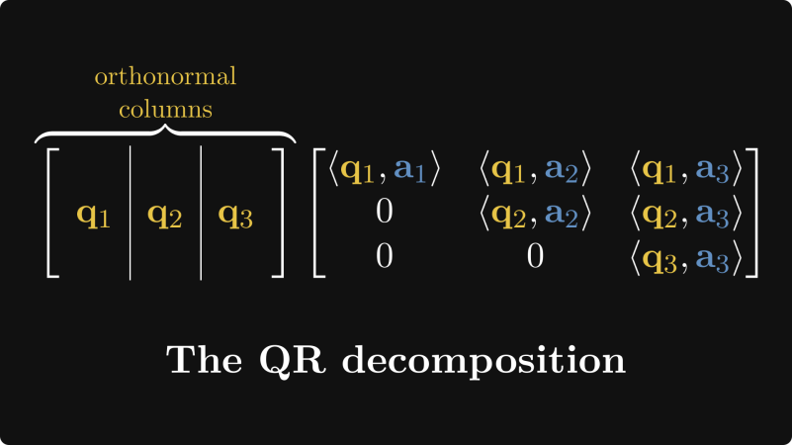
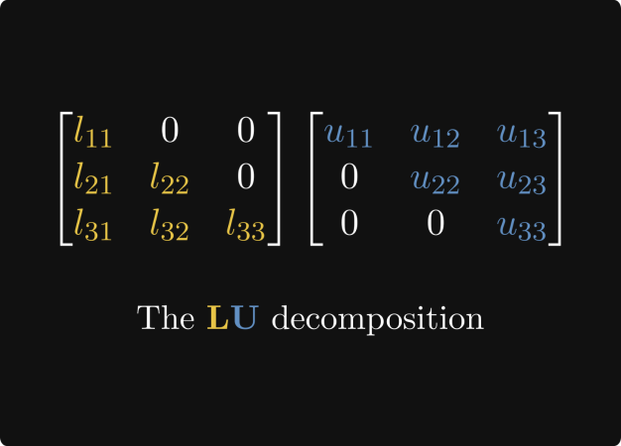
Solutions
Task 1
We consider to mix up different types of data to avoid revealing the amount of cotton of a certain types. The key point to achieve this goal is the capability of distinguishing different types in a mixed dataset.
Task 2
To accomplish task 2 we use least square method to solve linear regression. We choose QR and LU decomposition methods as candidates for matrix decomposition.
QR decomposition - Gram–Schmidt
LU - the product of a lower triangular matrix and upper triangular matrix

Slide 12
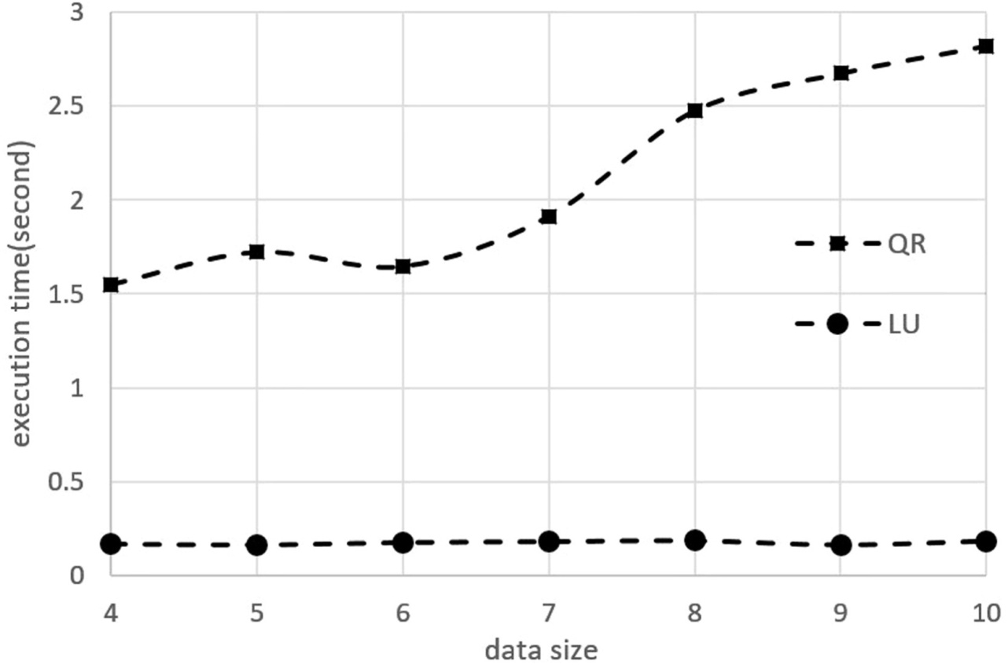
Results
Comparison of QR and LU decomposition for MPC
To compare the performance of our implemented QR and LU decomposition for MPC, we generate seven datasets. In each dataset, every participant has a matrix with 4 columns and N rows. N varies from 4 to 10 for these seven datasets.

Slide 13
Conclusions
Privacy preserving distributed data mining is an important task for big data. In this paper, we have proposed to utilize the MPC and SPDZ protocol to perform this task.
To accomplish these data mining tasks, we have proposed two solutions based on matrix computation with one-hot encoding and LU decomposition.

Slide 14


Thank you for your attention

